Slide 1





Data & Analytics Design | Implementation | Supports
Ashley Center
Account Executive
(425) 749-8568
acenter@affirma.com

Slide 2
About Affirma

Slide 3
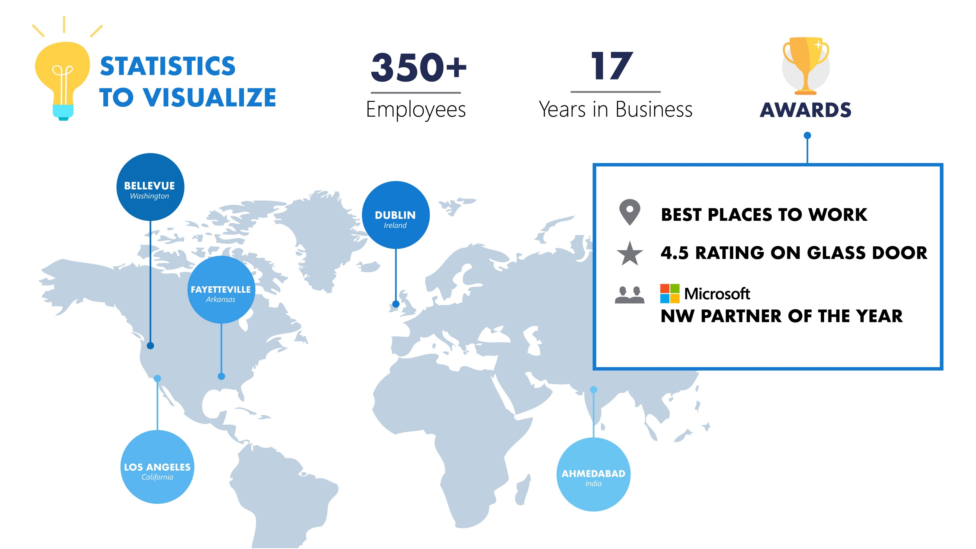
500+
18

Slide 4
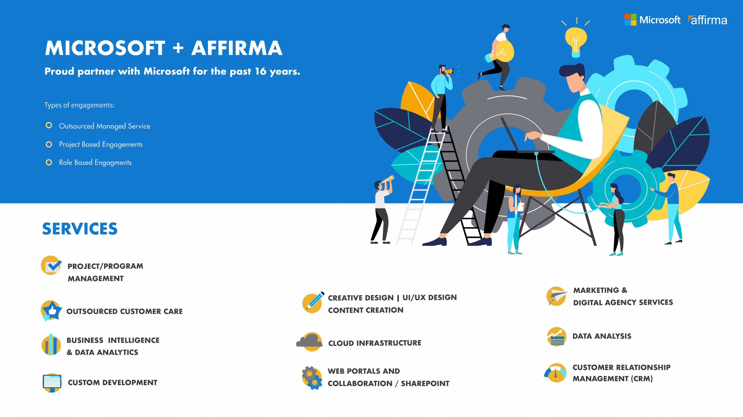
Proud Partner with Microsoft for the past 18 years.

Slide 5


Affirma & Microsoft
Gold Partner Status
As a Gold Partner, Affirma is a trusted partner and advisor to Microsoft clients. Our engineers are subjected to rigorous certification process yearly in order to keep our gold status. As a result, our teams are provided with the highest level of technical training and support from MS support.
Approved Supplier Status
As an Approved Supplier, Affirma works with a multitude of internal teams at Microsoft Corporation including Operations, Finance, Xbox and Devices & Hardware. We frequently help execute on their initiatives. This also allows us to build up experience with new technologies before the general public and competing consultants.
Managed Partner Status
As a Managed Partner, Microsoft engages Affirma to support some of their most strategic customers. Affirma acts as an extension of Microsoft’s implementation team and is held to a high level of customer satisfaction. Affirma is one of five hand selected Managed Partners in the West Region.
CSP Partner Status
As a Cloud Services Provider, Affirma can provide resale value licensing for any of Microsoft’s cloud services including Office 365, Azure and any other online offerings.

Slide 6
Managed Service

Slide 7

Microsoft OEM – Managed Service
Business Need
In April of FY17, Affirma was notified by MSFT that their existing vendor had “given notice” and was ending their engagement with MSFT – an annual spend of $4.7M. Affirma was asked to take over the entire book of business, with a transition timeline of 7-weeks and zero impact to the OEM business.
Team Size: 30
Location: Seattle, India, Reno, Dublin
Duration: April 2017 to Present
Industry: High Tech
Ongoing Partnership
Transition was seamless - Senior Executives within Operations praised the transition and acknowledged that there was zero impact between FY17 and FY18.
Team of 25-30 including Developers, Solution Architects, Project Managers, Business/Data Analysts.
Full support across business process management, DevOps, and ad-hoc project based work.
What We Did
Established a full team to support application development, solution architecture design, business process support, reporting and data analysis.
Brought India-based development team to the US to engage directly with onshore team members and accelerate onboarding.
Identified areas of redundancy, inefficiency and lack of automation across very manual processes.

Slide 8


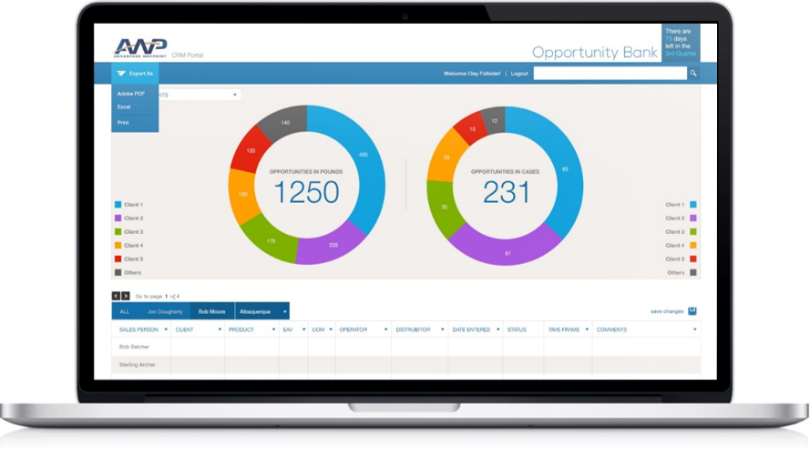
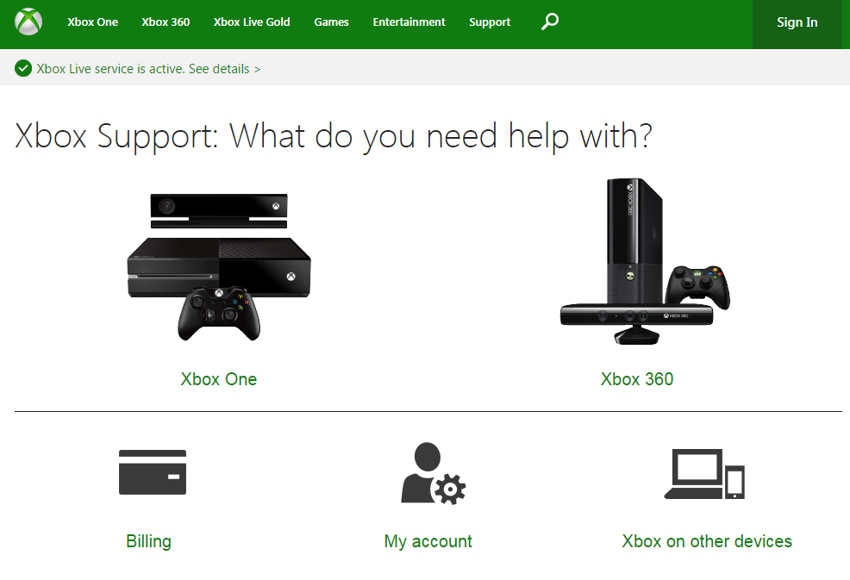
Xbox Customer Support / Ambassadors – Managed Service
Business Need
Customer Support Portal – support.xbox.com – conversion of legacy system to modernized website and self-service experience.
CRM Implementation – Case Management & escalation process
Design & Implementation of Xbox Ambassador program on Azure
Integrations – Integration Development between membership databases, social media platforms, and disparate data sources
Business Intelligence – Reporting and Data Visualization development for a variety of business units and stakeholder groups.
Team Size: 30
Locations: Seattle & India
Duration: August 2015 to Present
Industry: High Tech Gaming
Ongoing Partnership
25-30 full-time resources across development, support, leadership.
Integrated agile project management processes and platforms
Full augmentation of application development, business support, and various business processes across multiple stakeholder groups.

Slide 9
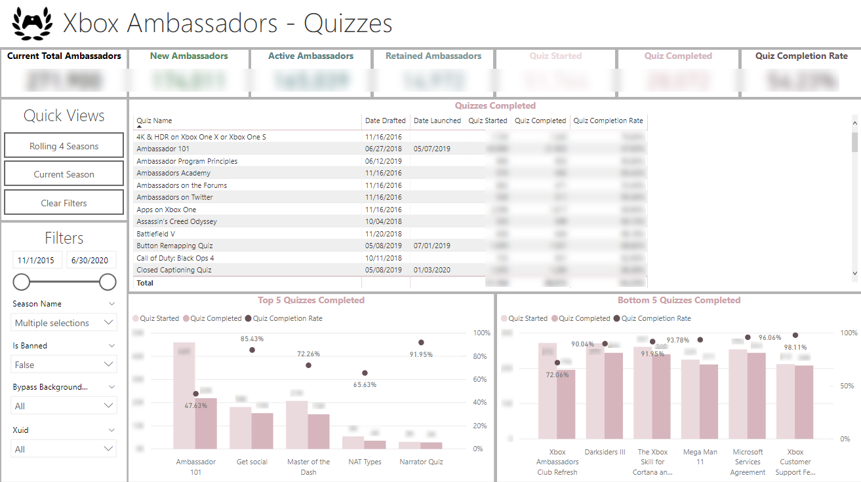
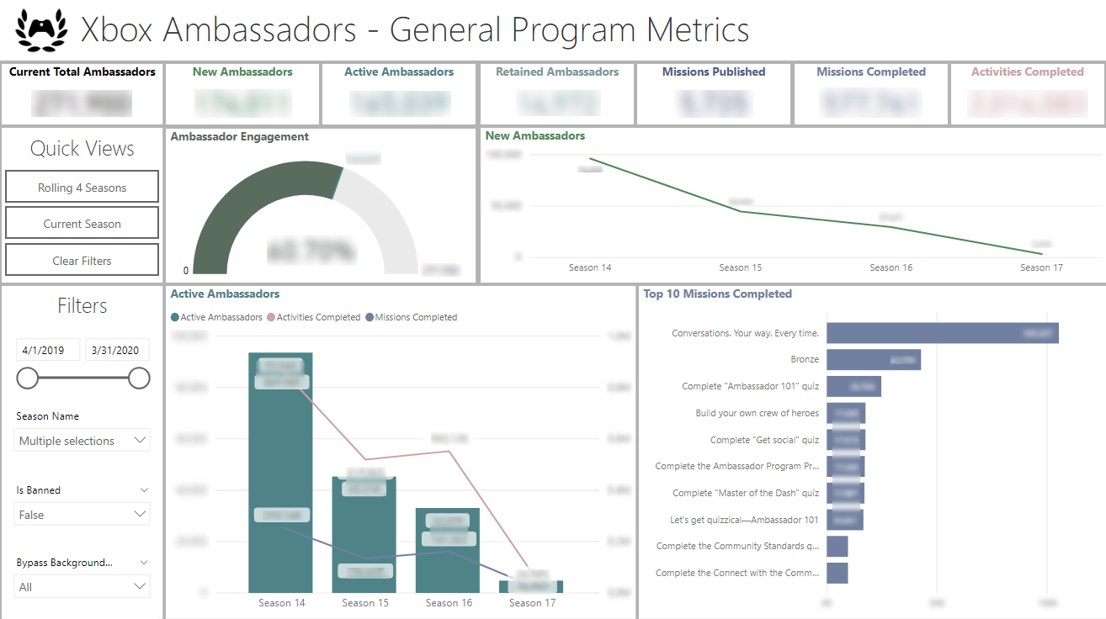
Xbox Ambassadors – Power BI Details
Power BI built using Kusto data source with billions of records.
Telling the story of how many users and what kind of activity they have achieved on their gamified site.
Includes Adobe Analytics connection for site statistics.
Ongoing engagement with support and quarterly additions .

Slide 10

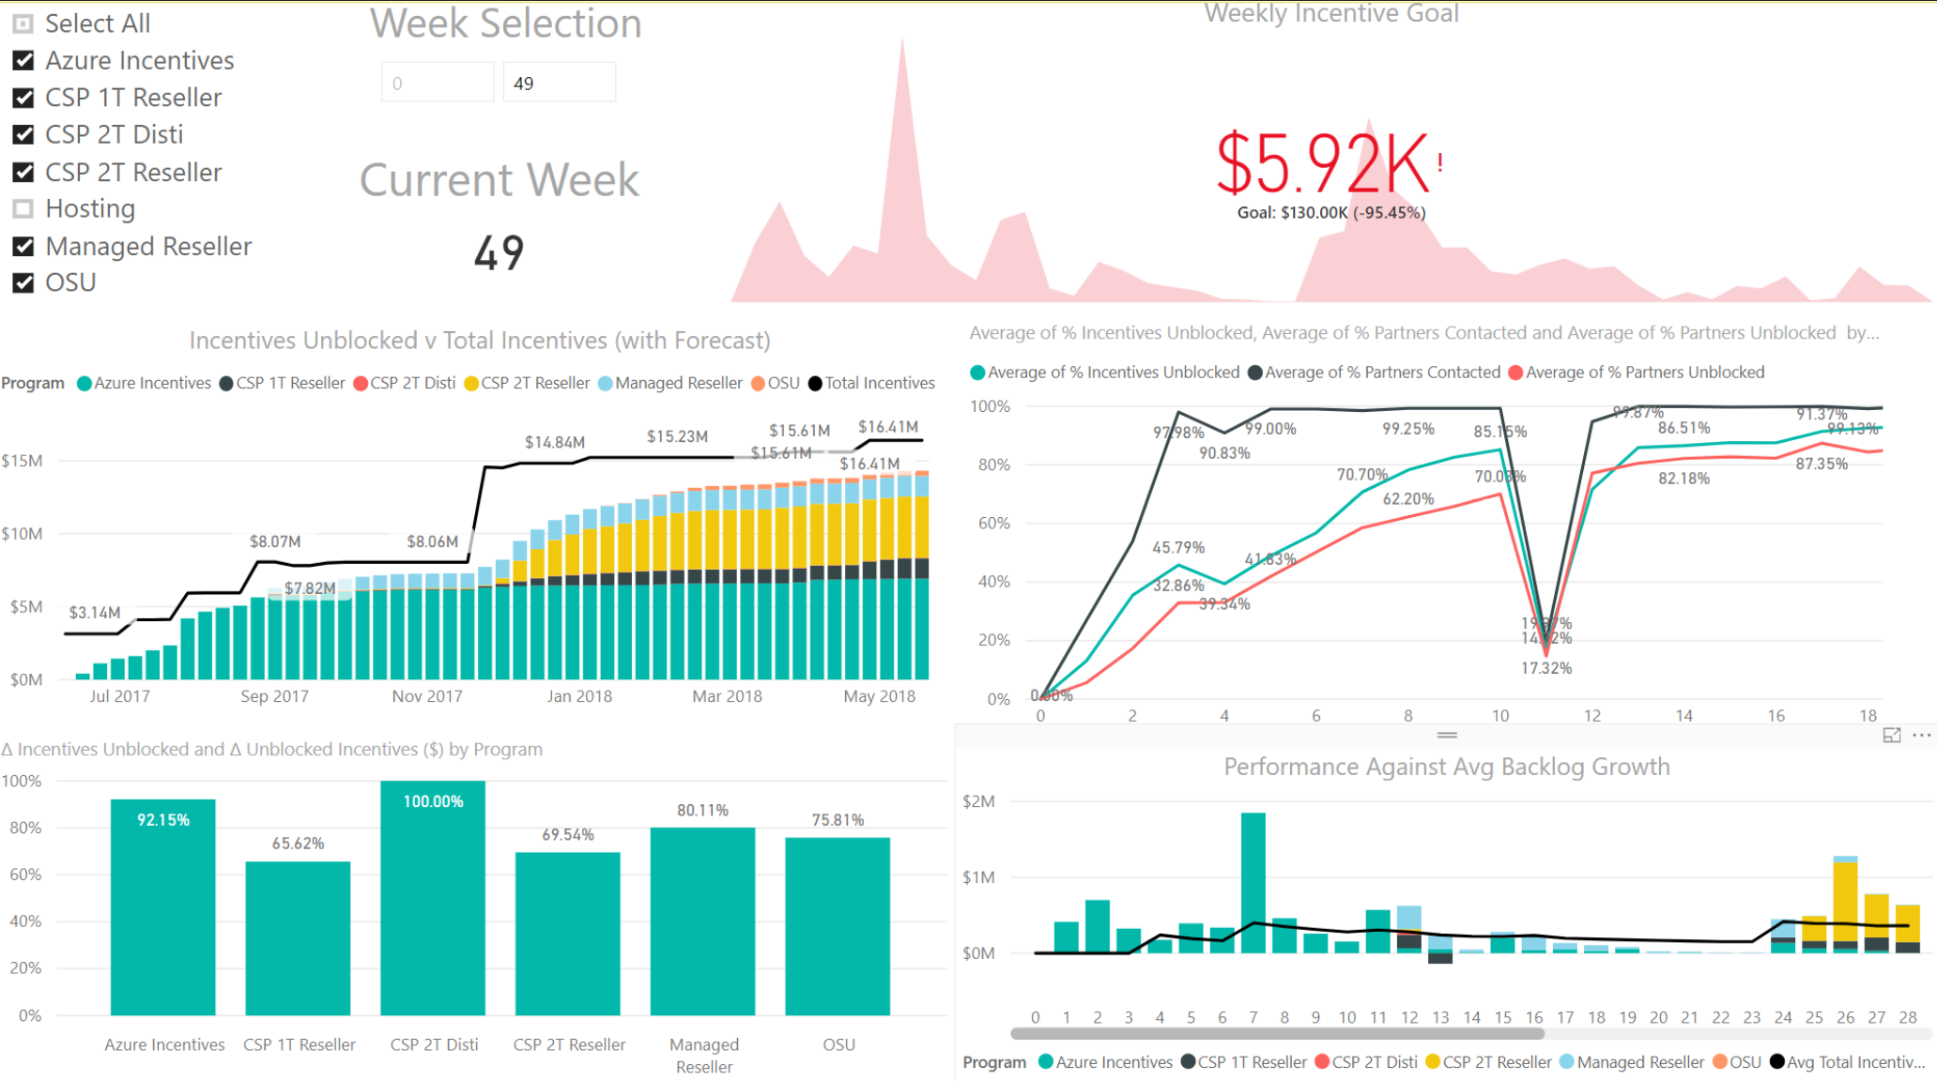
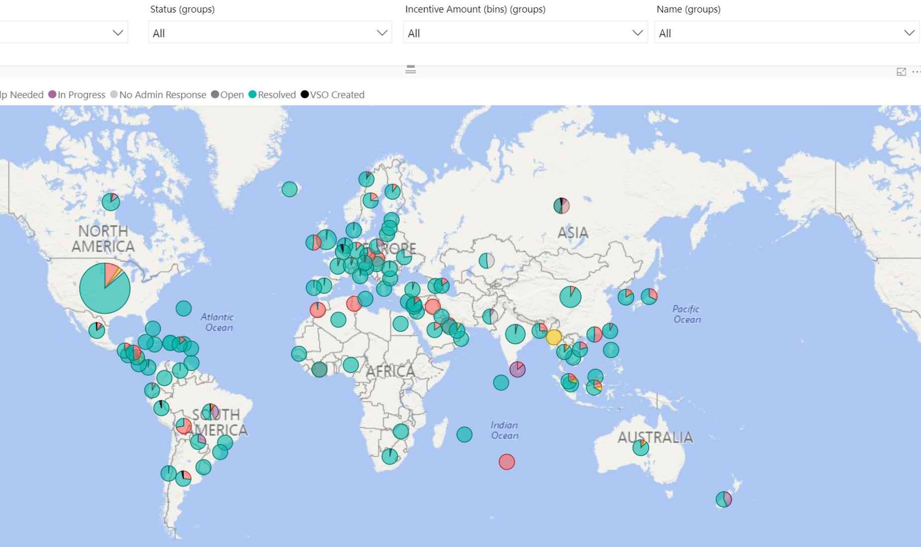
Microsoft – Xbox PowerBI Samples

Slide 11

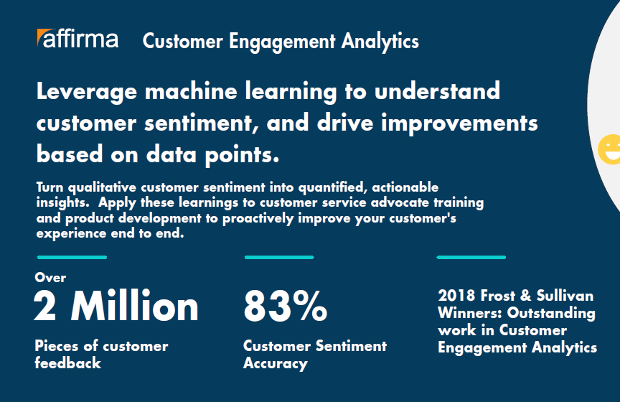
Microsoft - Voice of the Customer Team
Business Need
Microsoft came to Affirma looking for support in their Voice of the Customer initiative. The goal was to capture qualitative customer sentiment and turn it into quantifiable, actionable insights.
Ongoing Partnership
Affirma established a team of 10 resources including Project Management, Architects and Software Engineers
The team developed a solution leveraging Azure Machine Learning, Power BI and custom development.
The solution aggregates customer sentiment across chat data, survey verbatims, social media, and other data sources.
These insights are proactively applied across the business including; customer advocate training, product development, survey experiences and more.
Affirma’s team continues to provide ongoing enhancements to the solution and business support for reporting and analysis.
Microsoft VOC
Team Size: 10
Locations: Seattle
Duration: 2017 to Present
Industry: High Tech

Slide 12
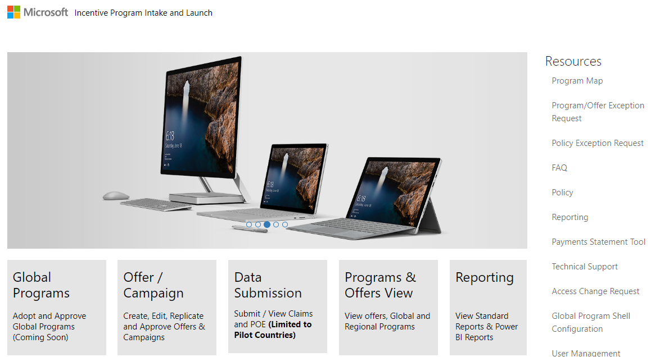
Microsoft – Operations Managed Service
Business Need
Microsoft’s Operations group had a global need for business process support and technical leadership across various teams. The need spanned from solution architecture design and application development, to business process administration and reporting. Affirma onboarded a comprehensive team to fill these gaps and add substantial business value for Microsoft.
Microsoft Operations
Team Size: 80
Locations: Seattle, India, Reno, Dublin
Duration: 2015 to Present
Industry: High Tech
Ongoing Partnership
Affirma has established a long term relationship with the Operations group and our team continues to grow as we support new initiatives. Ongoing services include:
Application design and development
Solution architecture redesign
Business Intelligence & Analytics
Ongoing enhancements & break-fix support
3rd party vendor collaboration and management
Business process support & change management

Slide 13

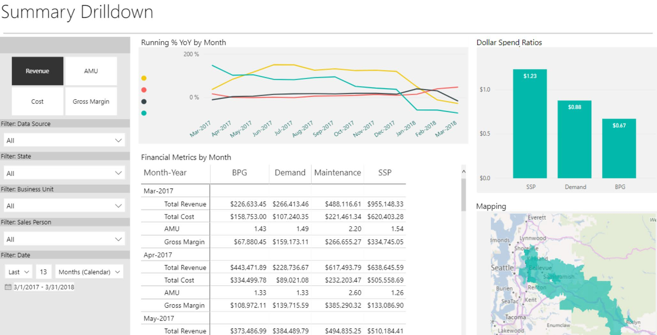


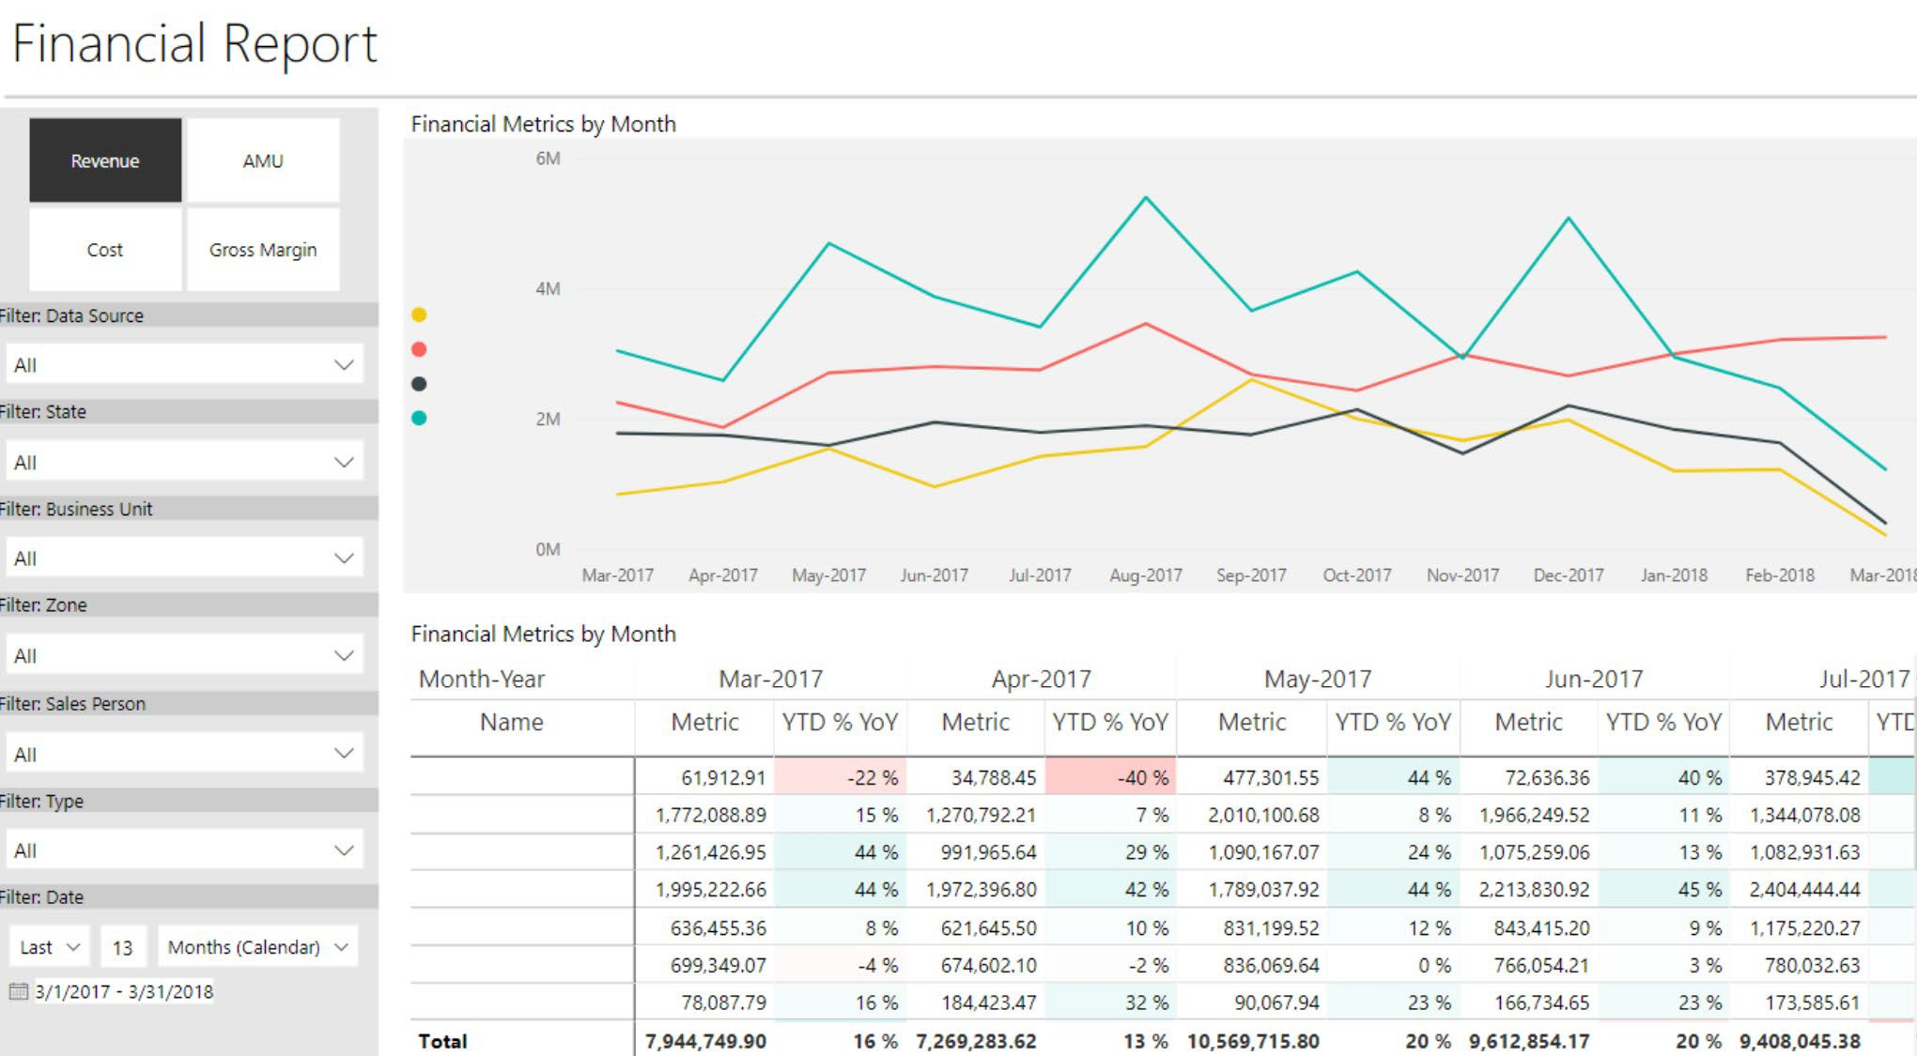

Macdonald Miller - PowerBI
Duration: 2019 – Present
Industry: Logistics
Ongoing Partnership
Data & Analytics resource supporting PowerBI

Slide 14
End-end

Slide 15


Alorica - Data Lake & Analytics Implementation
Ongoing Partnership
27-30 full-time Affirma resources including Scrum Master, Solution Architects, Application Engineers & Data Engineers
Azure Data Lake Solution with 30+ complex data sources across fragmented enterprise environments
Cloud-first, API-driven architecture built to scale
Running agile scrum methodology with 2 sprint cycles across complex multi-org environment
Flexible resourcing with ability to scale up or down on monthly basis
Team Size: ~30
Location: Seattle, India
Duration: Jan 2019 – Present
Industry: Customer Service

Slide 16






Crane Aerospace – Data Lake
Business Need
Crane Aerospace was looking for a vendor to create data pipelines from their testing equipment to be able to provide analytics on the gigabytes of test data created every month. Crane creates hundreds of flat files per day on a server that could not be shut down or modified due to government restrictions. Therefore, Crane was looking for a solution to gather the files and create a pipeline to a data lake for reporting and analytics all while being able to archive the files off existing expensive on premise file servers.
What We Did
Affirma designed an ETL and data lake; with file ingestion through Azure data factory and transformation using pySpark in HDInisghts.
The raw data and files was kept in the data lake while the process transformed the data into a SQL database for analytic consumption and reporting in PowerBI.
Business units we able to see the data on the requested 6-hour batch process from file server to PowerBI for new measurements and analytics on test equipment throughput and results.
Team Size: 3
Location: Remote
When: 2019
Industry: Manufacturing

Slide 17
Data Visualization

Slide 18

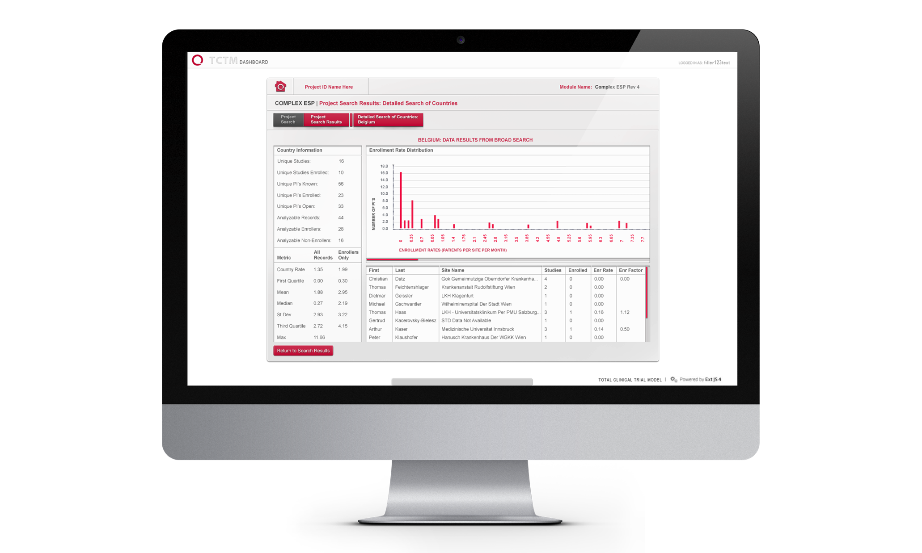
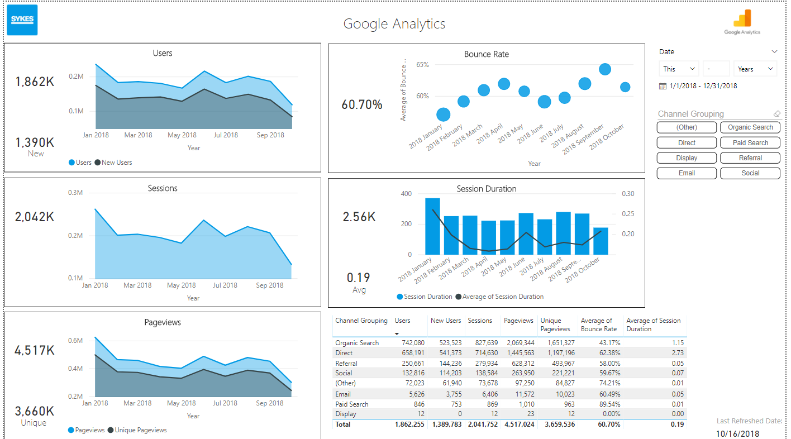
SYKES - Power BI Marketing Analytics
What We Did
Affirma engaged with the Global Marketing team at SYKES to build analytics around campaign performance and marketing ROI.
This work included developing custom Power BI connectors for Twitter, Facebook, LinkedIn, and Google Analytics.
Their data was then summarized and sliced by campaign to help tell the story of how marketing strategy impacted performance across campaigns and events.
Team Size: 3
Location: Remote
Duration: Jan 2019 – Dec 2019
Industry: Staffing

Slide 19
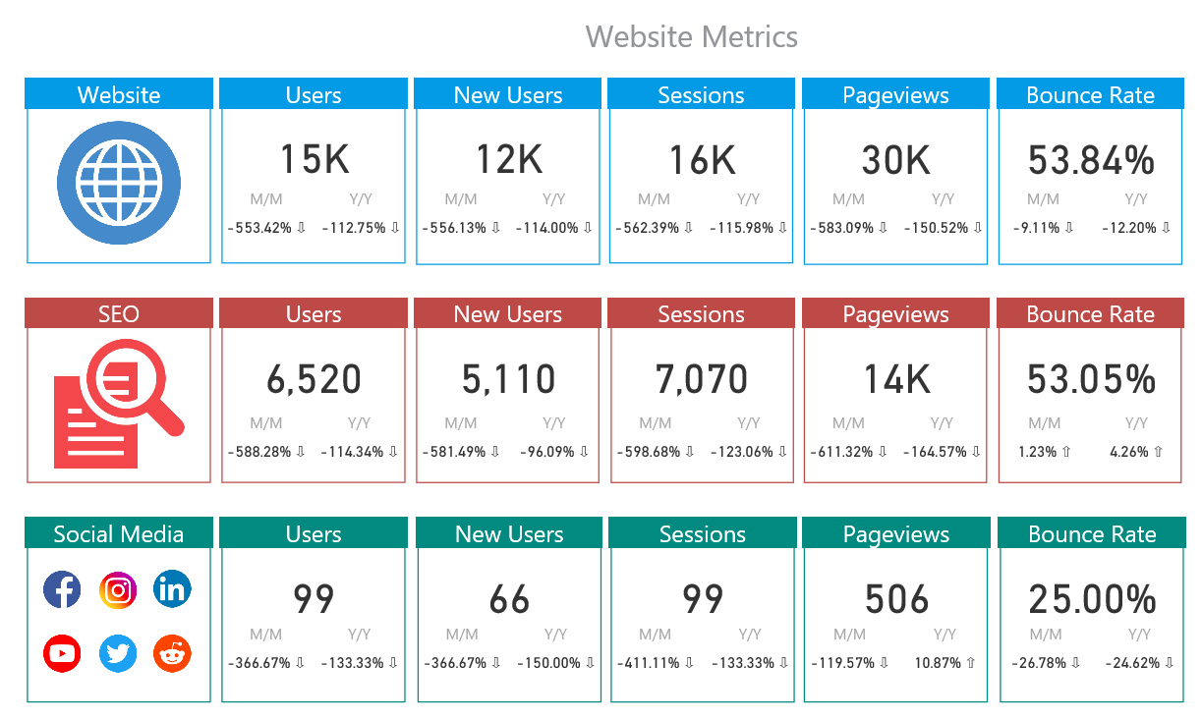
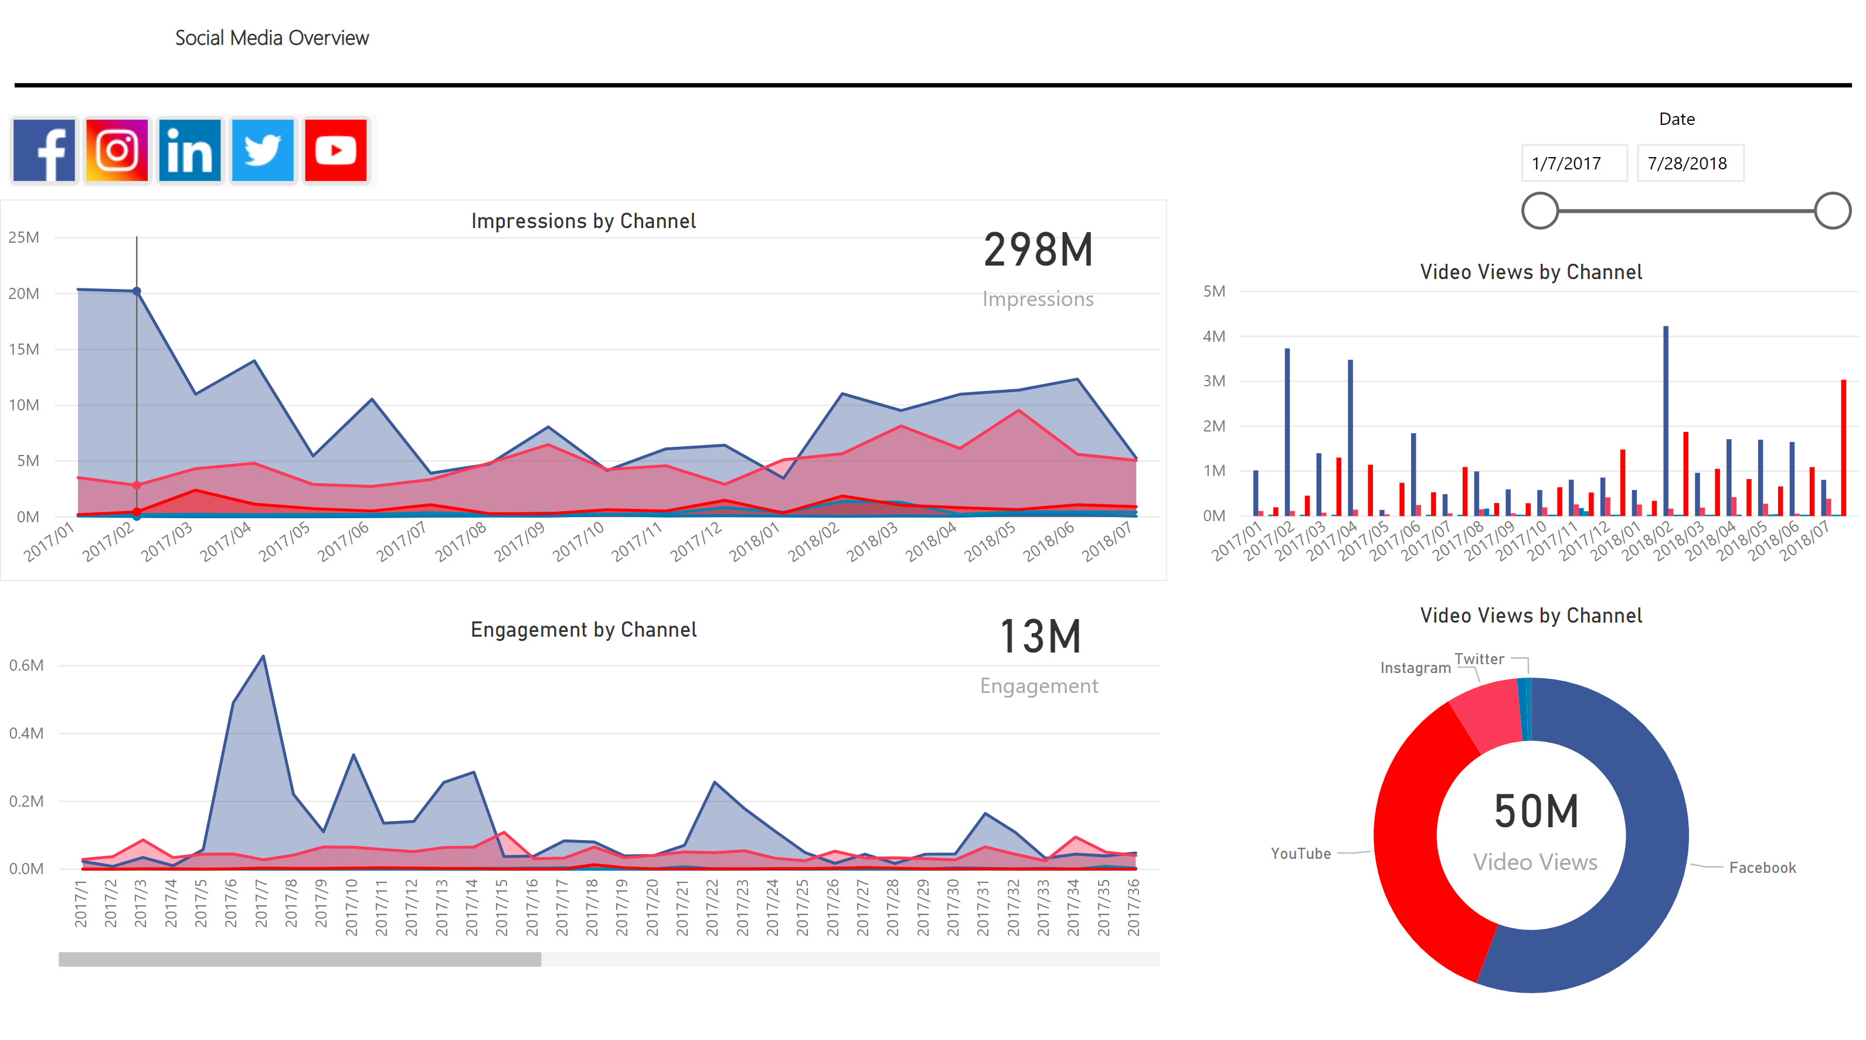
SYKES - Power BI Marketing Analytics
Website Metrics

Slide 20

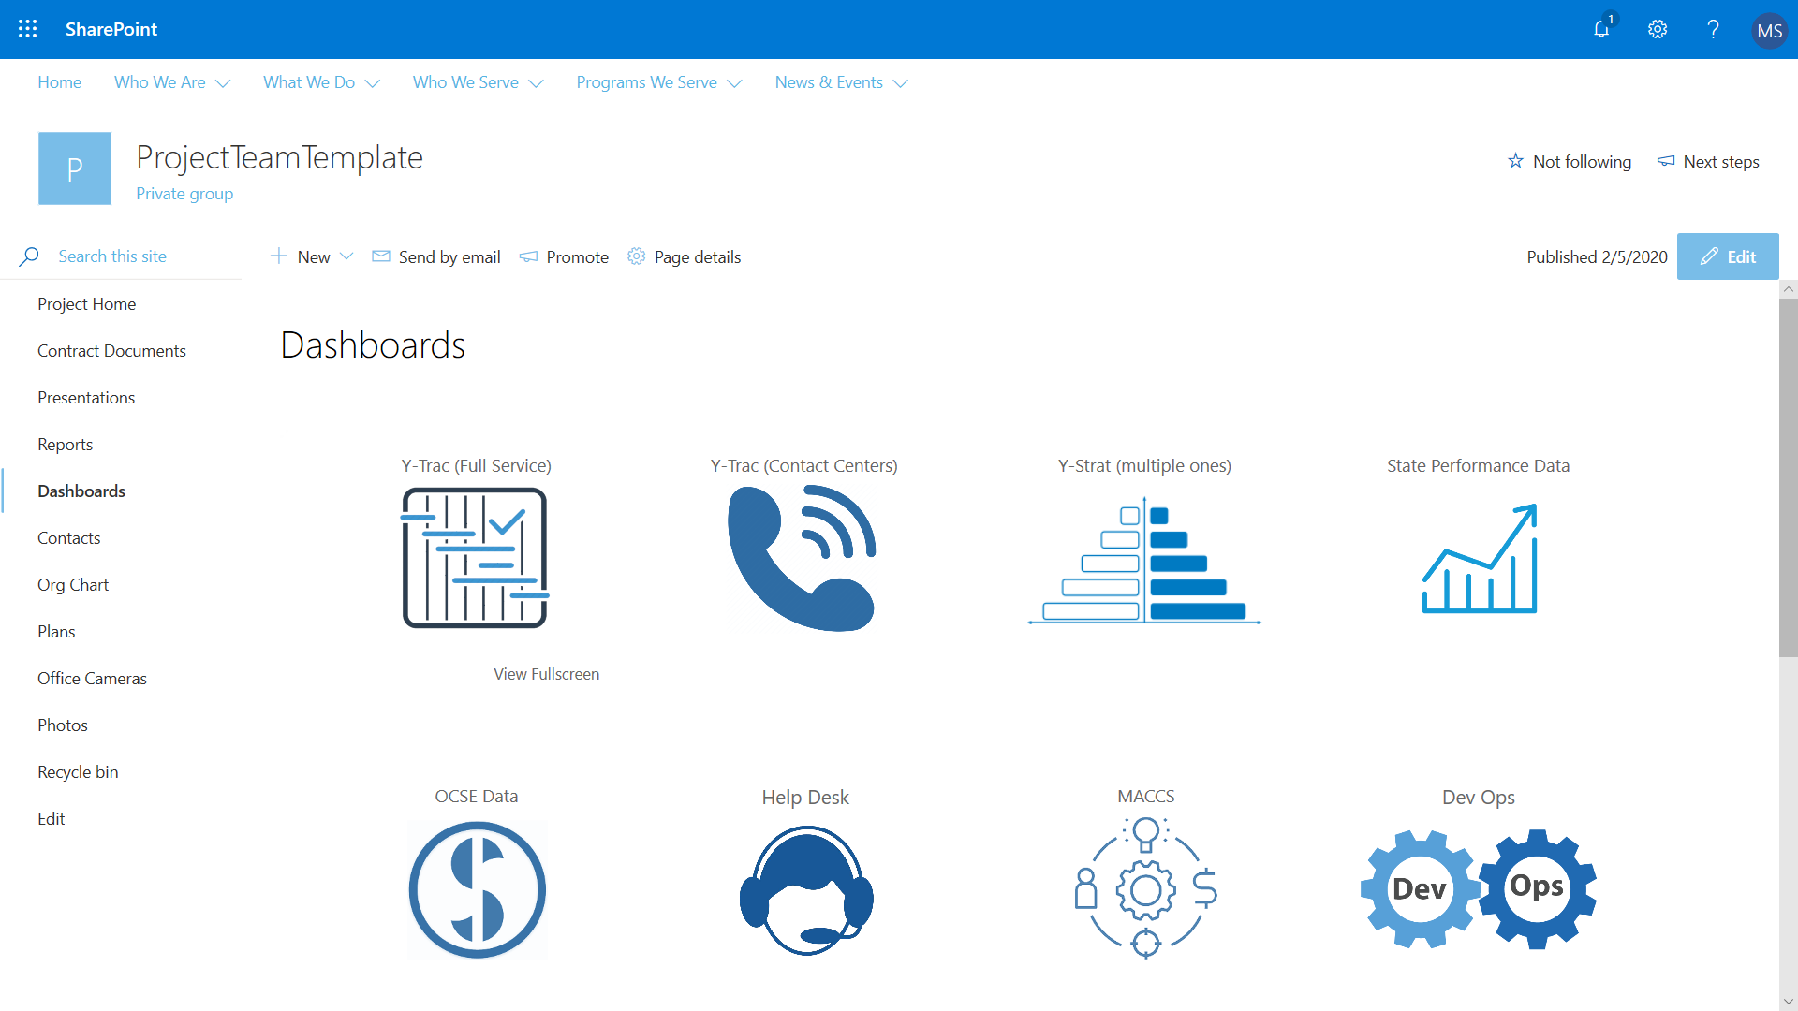
YoungWilliams – PowerBI Embedding
Team Size: 8
Location: Remote
Duration: 2019 – Ongoing
Industry: Non-Profit
Business Need
YoungWilliams was looking for a vendor to create SharePoint portal with embedded PowerBI Dashboard. The solution had to take in account internal and external users while taking in account row level security.
What We Did
Affirma designed and implemented a modern SharePoint site.
Affirma provided best practices and structure around the PowerBI embedding and row level security.
We developed a portal Dashboard that allows one central landing page in SharePoint acting as the hub for reporting.
We provided training and an Admin guide to support YoungWilliams long term portal goals.

Slide 21

Credit Union – PowerBI
Business Need
A community Credit Union identified a gap in their business around being able to provide consistent and accessible reporting across different business units. They were capturing a high volume of data, but struggled with putting that data in the hands of their decision makers, and lacked a system to easily visualize that data for distribution across their organization.
What We Did
Affirma conducted stakeholder interviews to outline the most important features required in their reporting environment. We then guided them through the tool selection process: assessing Power BI, Tableau, and other platforms against the criteria; participating in product demos; and applying actual reporting scenarios to the products under consideration.
We provided insights and sample charters on the structure of a data and reporting steering committee.
Two tailored training sessions were conducted to train data modelers and report authors, from technical and non-technical perspective.
Team Size: 2
Location: Remote
Duration: 2019
Industry: Banking
The Result
Power BI was adopted by the organization and comprehensive documentation to support the decision was provided.
Trainings were conducted to empower individuals from IT personnel to branch managers on how to access data and build out reports, using a central data connection as a single source of truth.

Slide 22
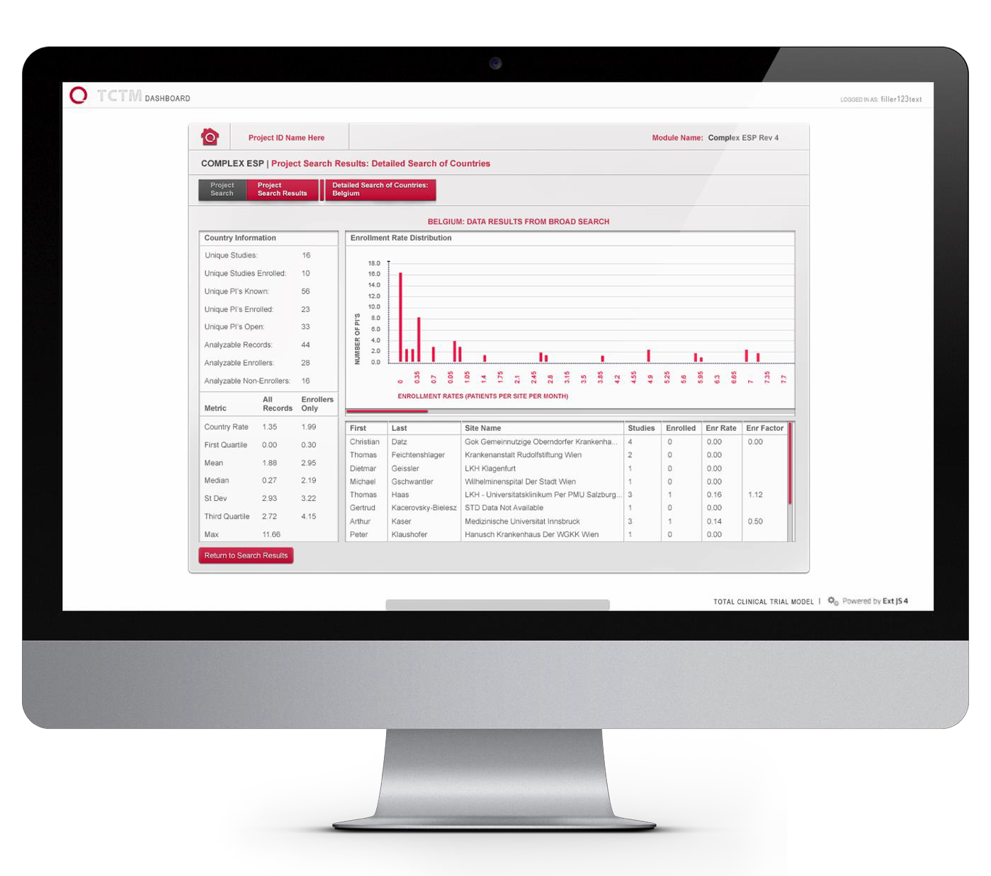
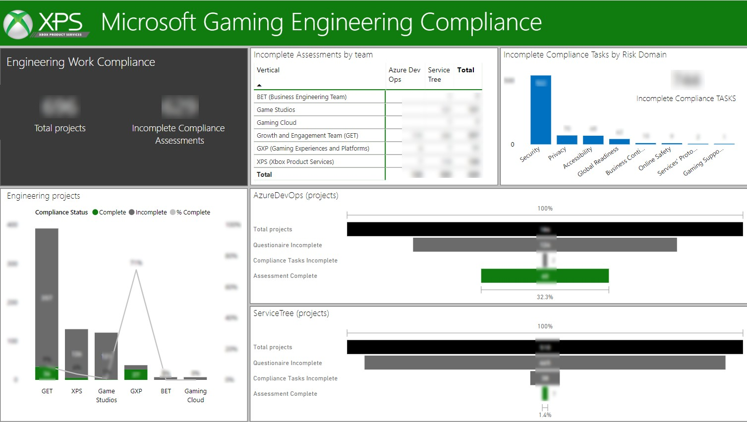

Microsoft | Gaming Compliance Reporting
What We Did
The Gaming Compliance program at Microsoft reached out to Affirma support in developing comprehensive reporting and analytics with Power BI.
The program’s leadership team needed to tell a story of
accountability across the various engineering teams.
Affirma worked with them to review the data available across several source systems and determine the most impactful analysis that we could automate.
Several Power BI dashboards were created to manage the ongoing work of these teams, and ensure that compliance standards are consistently being met or exceeded.
Primary metrics include completed tasks by team, complete/incomplete projects by team, and compliance achievement across programs.

Slide 23
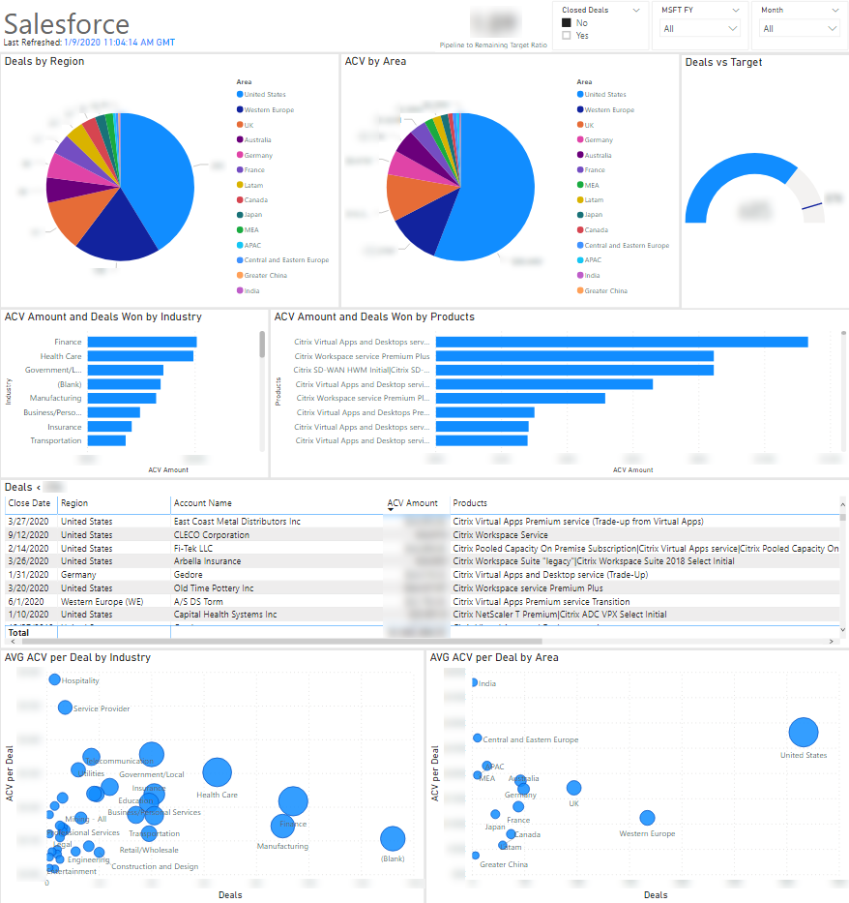
Microsoft – Citrix CoSell Power BI
Locations: Seattle
Duration: 2019
Industry: High Tech Gaming
What We Did
Microsoft works with their partners to help create sales goals.
This report helps show by geography and by product the amount of deals and dollars they are bringing in compared to their goals.
Sources include Excel files from the partner and Microsoft cubes.

Slide 24
Thank You

